Slide 1
Mips2
By Brycen, Sparsh, Garrett

Slide 2
Instructions
la - used to load string into program
sw - used to store ra
Lw - used to show string
Lb - used to get char bytes
Sb - used to break up chars
Addi - used to increment stack and through words
Beq - used to decide if we are done in loop yet
J - used to recurse method
Jr - used to return ra

Slide 3
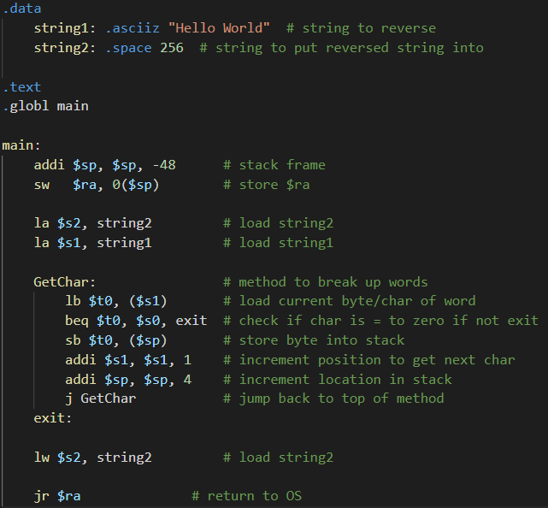
Neat listing
Code Showing

Slide 4
Analysis
The code was fun to make and every part seemed to flow really well into the next. The parts that were disliked were figuring out how the stack worked as it is weird to increment and decrement and for some reason the load word commands just don't seem right to use.
The algorithm is not super efficient due to the fact the stack increments by 4 bytes to store a single char and we have no idea if we can increment in smaller segments
We don't see a huge use for this to test a microprocessor but we suppose to run a benchmark it could be useful to test if it can run code that's not optimized

